Slide 1

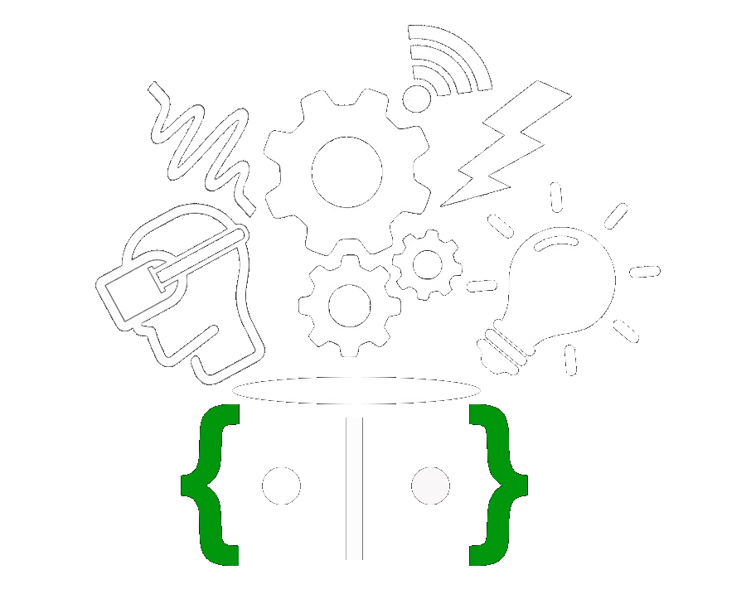
HashCode 11
Natural Disaster Prevention, Management and Recovery
idkWhatWe’reDoing
M Aswartha Reddy | DK Bharath Reddy | Pulkit Dhamija | Shishira M Iyar
R. V. College of Engineering

Slide 2
Problem Statement
In natural disasters like flood, all communication infrastructure breaks down, leaving victims to fend for themselves
Our solution aims to:
Create an easy to use mesh network that can be accessed by people in distress without prior knowledge
Provide a basic communication network to emergency services
Help emergency personnel to locate people in need as soon as possible

Slide 3
Solution Description
The mesh network is made up of multiple floating devices.
These devices create a captive portal that users can connect to and communicate their status
Many such devices are monitored by a host device, which is relayed over to a rescue station
The data (user location and status) goes through multiple devices before arriving at the host devices
All the data can be monitored at the rescue station through an interactive dashboard
System is fully self-sustained and doesn’t require any external infrastructure like Internet or Cellular Network

Slide 4
Solution Workflow
Step 1
Step 2
Step 3
Enable users to connect to a rescue device from mesh network
Transfer the data received to rescue station
Data is monitored through dashboard and appropriate rescue measures are taken

Slide 5
Tech stack - Hardware
Captive portal is created on ESP8266
LORA Transceiver creates a mesh network
User’s location is captured with the GPS module
Solar panel charges the Li-Ion cells
Li-Ion Cells are used to power the device in absence of sunlight

Slide 6
Tech stack - Software
React is used for the dashboard
Google Maps SDK allows drawing of custom maps
React-google-maps is used to pin user’s location on the map
Firebase Realtime Database as a cloud database, to provide necessary information to rescue personnel

Slide 7
Feasibility
Intuitive and easy to follow process, that enables victims (including elderly), to receive necessary help (food, medicines, evacuation).
Since it is a zero configuration system, it is very easy to deploy, in case of an emergency.
The devices just have to be released into the water and they will do the rest.
This system provides rescue services to people in distress and helps in saving their lives.

